Slide 1
Chapter 3
Data and Signals (Transmission Impairments)

Slide 2
3-4 TRANSMISSION IMPAIRMENT
Signals travel through transmission media, which are not perfect. The imperfection causes signal impairment. This means that the signal at the beginning of the medium is not the same as the signal at the end of the medium. What is sent is not what is received. Three causes of impairment are attenuation, distortion, and noise.
Topics discussed in this section:
Attenuation
Distortion
Noise

Slide 3
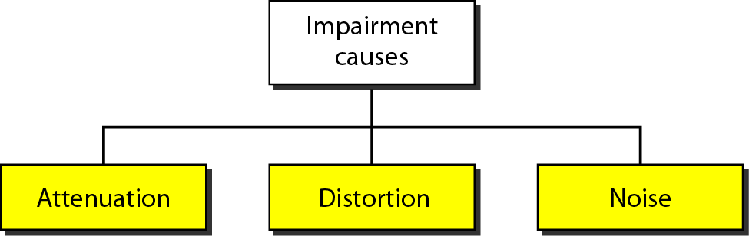
Figure 3.25 Causes of impairment

Slide 4
Attenuation
Means loss of energy -> weaker signal
When a signal travels through a medium it loses some of its energy in overcoming the resistance of the medium.
That is why a wire carrying electric signals gets warm after a while. Some of the electrical energy in the signal is converted to heat.
To compensate for this loss, amplifiers are used to amplify the signal.

Slide 5
Measurement of Attenuation
To show the loss or gain of energy the unit “decibel” is used.
To show that a signal has lost or gained strength, engineers use the unit of the decibel.
Decibel is negative if a signal is attenuated and positive if a signal is amplified.
dB = 10log₁₀P₂/P₁
P₁ - input signal
P₂ - output signal

Slide 6
Variables P_{I} and P₂ are the powers of a signal at points 1 and 2, respectively.
Decibel in terms of voltage instead of power, hence,
dB = 20log₁₀V₂/V₁
P₁ - input signal
P₂ - output signal

Slide 7
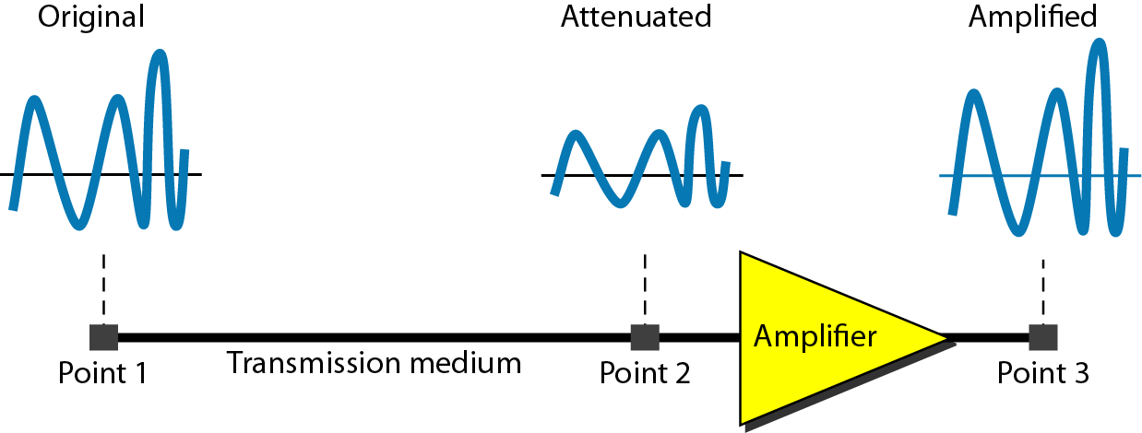
Figure 3.26 Attenuation

Slide 8

Example 3.26
Suppose a signal travels through a transmission medium and its power is reduced to one-half. This means that P2 is (1/2)P1. In this case, the attenuation (loss of power) can be calculated as
A loss of 3 dB (–3 dB) is equivalent to losing one-half the power.

Slide 9

Example 3.27
A signal travels through an amplifier, and its power is increased 10 times. This means that P₂ = 10P₁ . In this case, the amplification (gain of power) can be calculated as

Slide 10
Example 3.28
One reason that engineers use the decibel to measure the changes in the strength of a signal is that,
decibel numbers can be added (or subtracted) when we are measuring several points (cascading) instead of just two.
In Figure 3.27 a signal travels from point 1 to point 4.

Slide 11

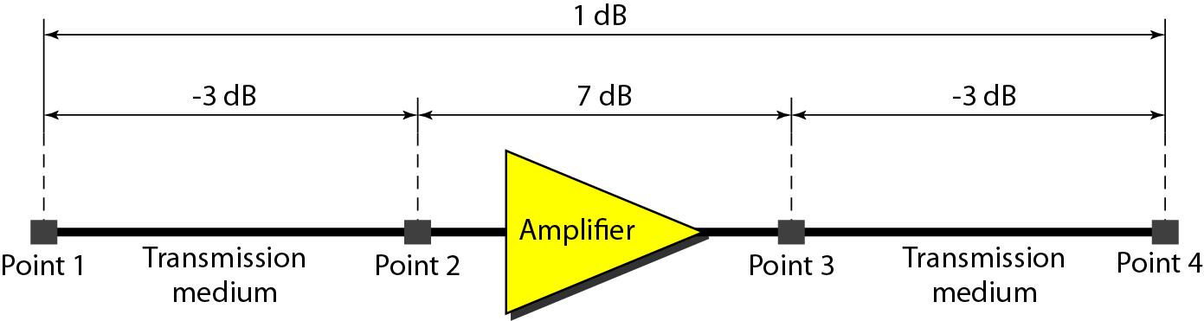
Figure 3.27 Decibels for Example 3.28
The signal is attenuated by the time it reaches point 2. Between points 2 and 3, the signal is amplified. Again, between points 3 and 4, the signal is attenuated.
We can find the resultant decibel value for the signal just by adding the decibel measurements between each set of points.
In this case, the decibel value can be calculated as

Slide 12
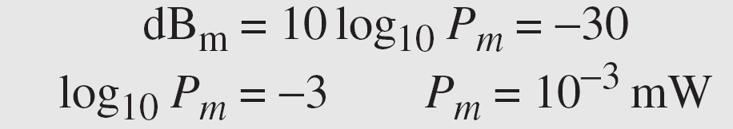
Example 3.29
Sometimes the decibel is used to measure signal power in milliwatts. In this case, it is referred to as dB_{m} and is calculated as dB_{m} = 10 log10 P_{m} , where P_{m} is the power in milliwatts. Calculate the power of a signal with dB_{m} = −30.
Solution
We can calculate the power in the signal as

Slide 13
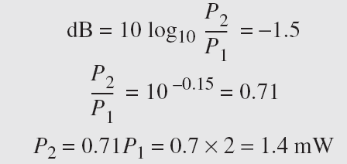
Example 3.30
The loss in a cable is usually defined in decibels per kilometer (dB/km). If the signal at the beginning of a cable with −0.3 dB/km has a power of 2 mW, what is the power of the signal at 5 km?
Solution
The loss in the cable in decibels is 5 × (−0.3) = −1.5 dB. We can calculate the power as

Slide 14
Noise
There are different types of noise
Thermal – random motion of electrons in the wire which creates an extra signal not originally sent by transmitter.
Crosstalk - Crosstalk is the effect of one wire on the other.
Impulse – Spikes (a signal with high energy in a very short time) that comes from power lines, lightning, etc.

Slide 15
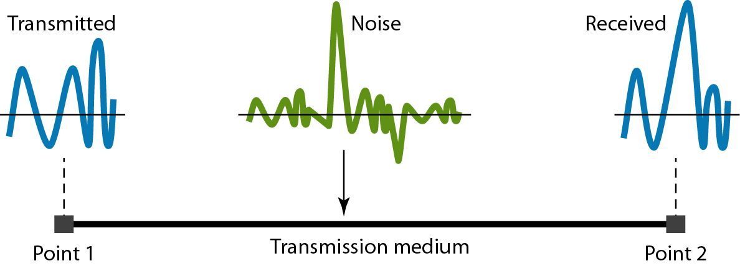
Figure 3.29 Noise

Slide 16
Signal to Noise Ratio (SNR)
To measure the quality of a system the SNR is often used. It indicates the strength of the signal wrt the noise power in the system.
It is the ratio between two powers.
It is usually given in dB and referred to as SNR_{dB.}

Slide 17
Example 3.31
The power of a signal is 10 mW and the power of the noise is 1 μW; what are the values of SNR and SNR_{dB} ?
Solution
The values of SNR and SNR_{dB} can be calculated as follows:

Slide 18
Example 3.32
The values of SNR and SNR_{dB} for a noiseless channel are
We can never achieve this ratio in real life; it is an ideal.

Slide 19
3-3 DIGITAL SIGNALS
In addition to being represented by an analog signal, information can also be represented by a digital signal. For example, a 1 can be encoded as a positive voltage and a 0 as zero voltage. A digital signal can have more than two levels. In this case, we can send more than 1 bit for each level.

Slide 20
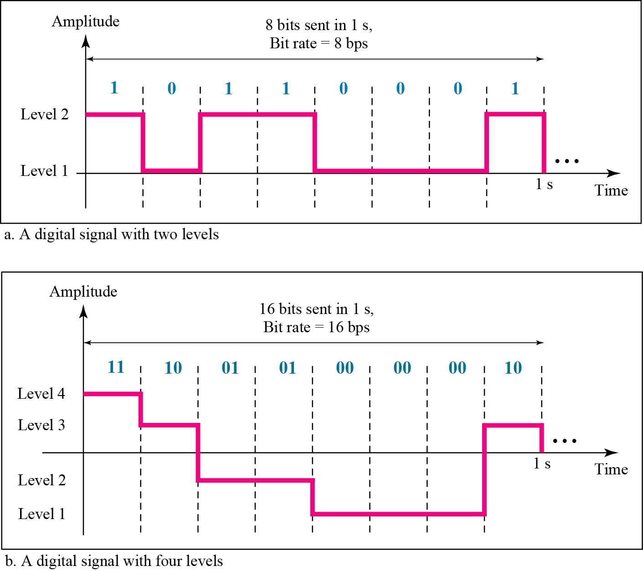
Figure 3.16 Two digital signals: one with two signal levels and the other with four signal levels

Slide 21
Example 3.16
A digital signal has eight levels. How many bits are needed per level? We calculate the number of bits from the formula
Each signal level is represented by 3 bits.

Slide 22
Example 3.17
A digital signal has nine levels. How many bits are needed per level? We calculate the number of bits by using the formula. Each signal level is represented by 3.17 bits. However, this answer is not realistic. The number of bits sent per level needs to be an integer as well as a power of 2. For this example, 4 bits can represent one level.

Slide 23
DATA RATE LIMITS
A very important consideration in data communications is how fast we can send data, in bits per second. over a channel. Data rate depends on three factors:
1. The bandwidth available
2. The level of the signals we use
3. The quality of the channel (the level of noise)
Two theoretical formulas were developed to calculate the data rate: one by Nyquist for a noiseless channel. another by Shannon for a noisy channel.

Slide 24
Noiseless Channel: Nyquist Bit Rate
For a noiseless channel, the Nyquist bit rate formula defines the theoretical maximum bit rate
BitRate = 2*BW*log₂L
BW is the bandwidth of the channel, L is the number of signal levels used to represent data, and BitRate is the bit rate in bits per second.

Slide 25
According to the formula, we might think that, given a specific bandwidth, we can have any bit rate we want by increasing the number of signal levels.
When we increase the number of signal levels, we impose a burden on the receiver.
If the number of levels in a signal is just 2, the receiver can easily distinguish between a 0 and 1.
If the level of a signal is 64, the receiver must be very sophisticated to distinguish between 64 different levels.
In other words, increasing the levels of a signal reduces the reliability of the system.

Slide 26
Consider a noiseless channel with a bandwidth of 3000 Hz transmitting a signal with two signal levels. The maximum bit rate can be calculated as.
Consider the same noiseless channel transmitting a signal with four signal levels (for each level, we send 2 bits). The maximum bit rate can be calculated as
We need to send 265 kbps over a noiseless channel with a bandwidth of 20 kHz. How many signal levels do we need?

Slide 27
Noisy Channel: Shannon Capacity
In reality, we cannot have a noiseless channel; the channel is always noisy.
In 1944, Claude Shannon introduced a formula, called the Shannon capacity, to determine the theoretical highest data rate for a noisy channel:
Capacity =bandwidth X log₂ (1 +SNR)

Slide 28
In the Shannon formula there is no indication of the signal level, which means that no matter how many levels we have, we cannot achieve a data rate higher than the capacity of the channel.
The formula defines a characteristic of the channel, not the method of transmission.
Consider an extremely noisy channel in which the value of the signal-to-noise ratio is almost zero. In other words, the noise is so strong that the signal is faint. For this channel the capacity C is calculated as
Capacity =bandwidth X log₂ (1 +SNR) = bandwidth X log₂ (1 +0) = 0
We cannot receive any data through this channel.

Slide 29
We can calculate the theoretical highest bit rate of a regular telephone line. A telephone line normally has a bandwidth of 3000 Hz assigned for data communications. The signal-to-noise ratio is usually 3162. For this channel the capacity is calculated as
The signal-to-noise ratio is often given in decibels. Assume that SNR_{db} = 36 and the channel bandwidth is 2 MHz. The theoretical channel capacity can be calculated as:
SNR_{db} = 10log₁₀SNR = 10^{3.6}

Slide 30
Using Both Limits
In practice, we need to use both methods to find the limits and signal levels. Let us show this with an example.
We have a channel with a I-MHz bandwidth. The SNR for this channel is 63. What are the appropriate bit rate and signal level?
C =BW X log₂ (1 +SNR) = 6Mbps
The Shannon formula gives us 6 Mbps, the upper limit. For better performance we choose something lower, 4 Mbps, for example. Then we use the Nyquist formula to find the number of signal levels.
BitRate = 2*BW*log₂L => 4Mbps =2*1MHz*log₂L => L=4

Slide 31
The Shannon capacity gives us the upper limit;
the Nyquist formula tells us how many signal levels we need

Slide 32
Performance
Bandwidth
-- Bandwidth in Hertz (range of frequencies a channel can pass)
* For example, we can say the bandwidth of a subscriber telephone line is 4 kHz.
-- Bandwidth in Bits per Seconds (number of bits per second that a channel, a link, or even a network can transmit.)
* For example, one can say the bandwidth of a Fast Ethernet network (or the links in this network) is a maximum of 100 Mbps. This means that this network can send 100 Mbps.

Slide 33
Throughput
The throughput is a measure of how fast we can actually send data through a network.
Bandwidth is a potential measurement of a link; the throughput is an actual measurement of how fast we can send data.
A network with bandwidth of 10 Mbps can pass only an average of 12,000 frames per minute with each frame carrying an average of 10,000 bits. What is the throughput of this network?

Slide 34
Latency
The latency or delay defines how long it takes for an entire message to completely arrive at the destination from the time the first bit is sent out from the source.
Latency =propagation time +transmission time +queuing time + processing delay

Slide 35
Propagation Time
Propagation time measures the time required for a bit to travel from the source to the destination.
The propagation time is calculated by dividing the distance by the propagation speed.
The propagation speed of electromagnetic signals depends on the medium and on the frequency of the signal.
For example, in a vacuum, light is propagated with a speed of 3 x 10⁸ m/s. It is lower in air; it is much lower in cable.

Slide 36
What is the propagation time if the distance between the two points is 12,000 km? Assume the propagation speed to be 2.4 x 10⁸ m/s in cable.

Slide 37
Transmission Time
The time taken by host to put the packet on outgoing link is called Transmission Time.
Transmission Time = Message Size/ Bw
What are the propagation time and the transmission time for a 2.5-kbyte message (an e-mail) if the bandwidth of the network is 1 Gbps? Assume that the distance between the sender and the receiver is 12,000 km and that light travels at 2.4 x 10⁸ mls.

Slide 38
Queuing and Processing Time
The time needed for each intermediate or end device to hold the message before it can be processed.
The queuing time is not a fixed factor; it changes with the load imposed on the network.
When there is heavy traffic on the network, the queuing time increases.
An intermediate device, such as a router, queues the arrived messages and processes them one by one.
If there are many messages, each message will have to wait.

